Slide 1
Williamsburg-Housing
Gregory Prosper
Zainub Baig
Shukura Smart
Jevon Cheung
Nicholas Sankoe
Doris Qiu

Slide 2
Key Points
Easy to Use
Mobile Friendly
Secure

Slide 3
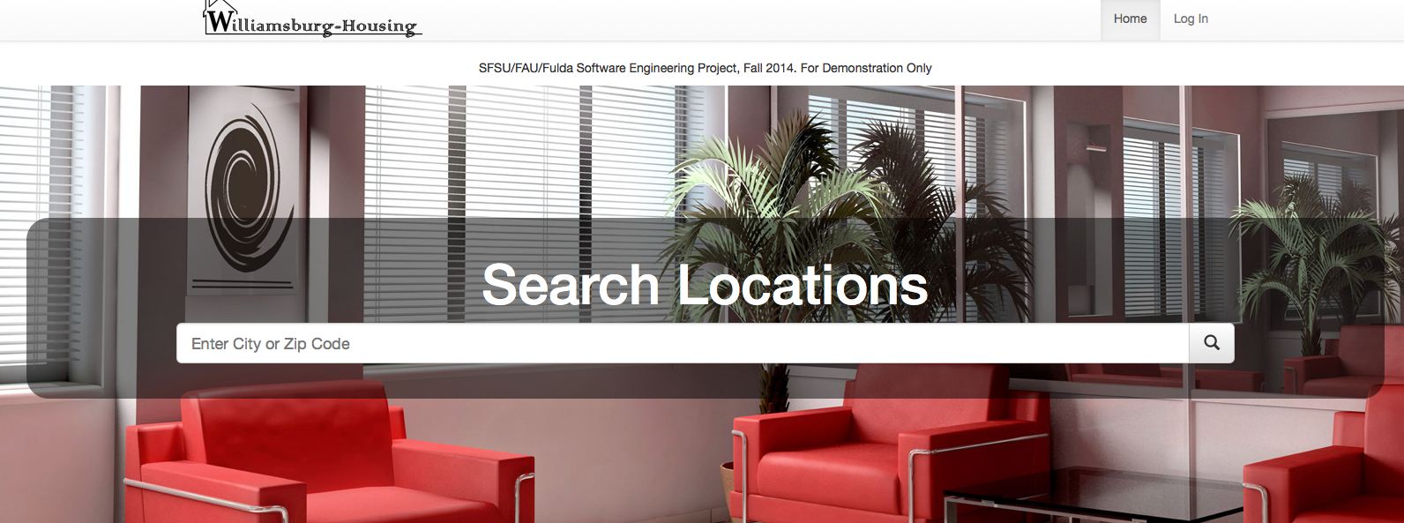
Easy to use
Search by City or Zip Code

Slide 4
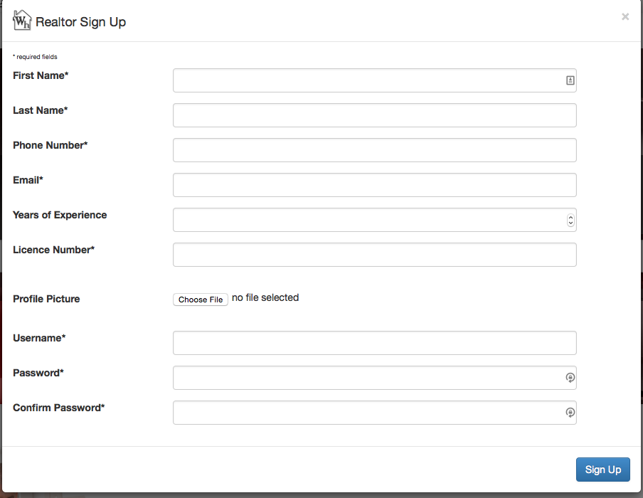
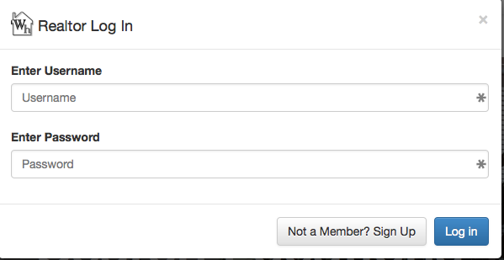
Easy to use (Continued)
Easy Sign Up and Log In

Slide 5
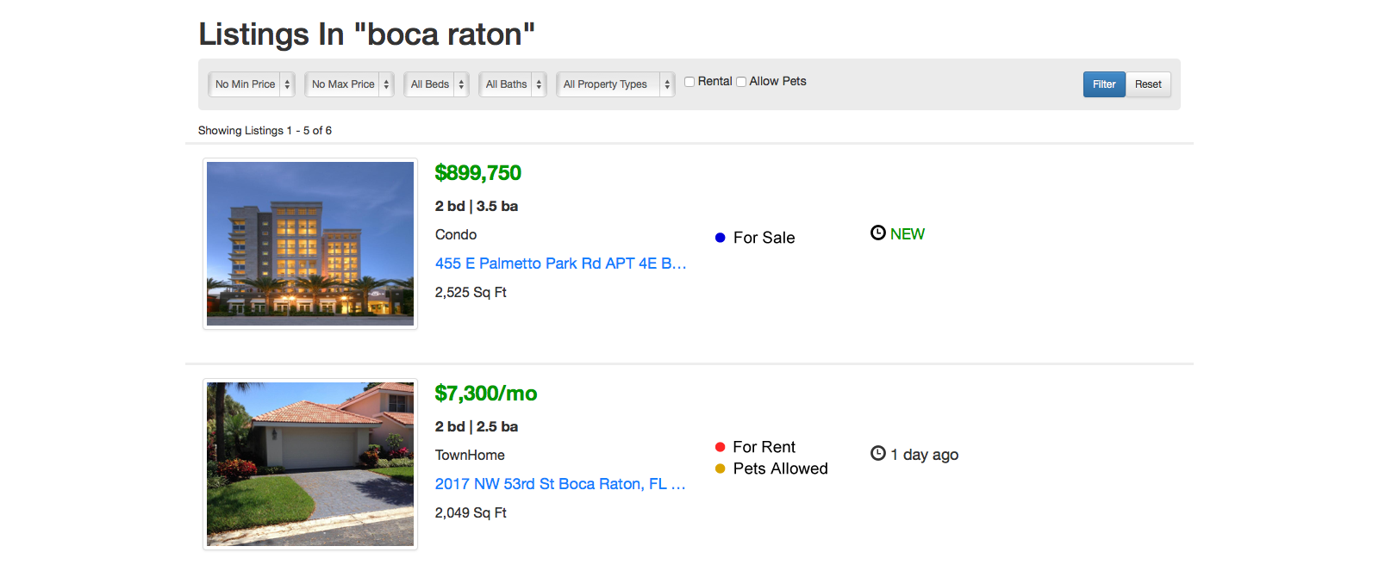
Easy to use (Continued)
Quick & Easy to Filter Results

Slide 6
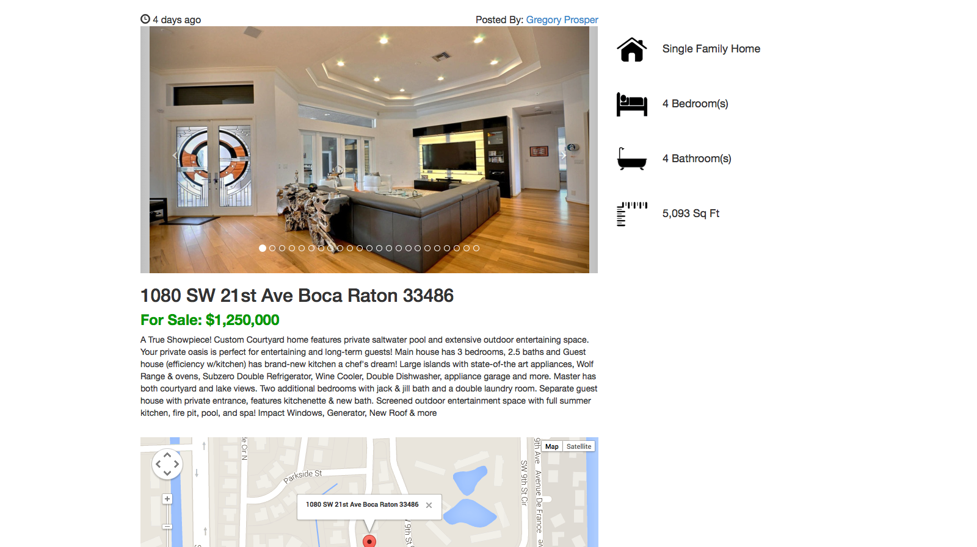
Easy to use (Continued)
Property Info Is Easy To Read

Slide 7
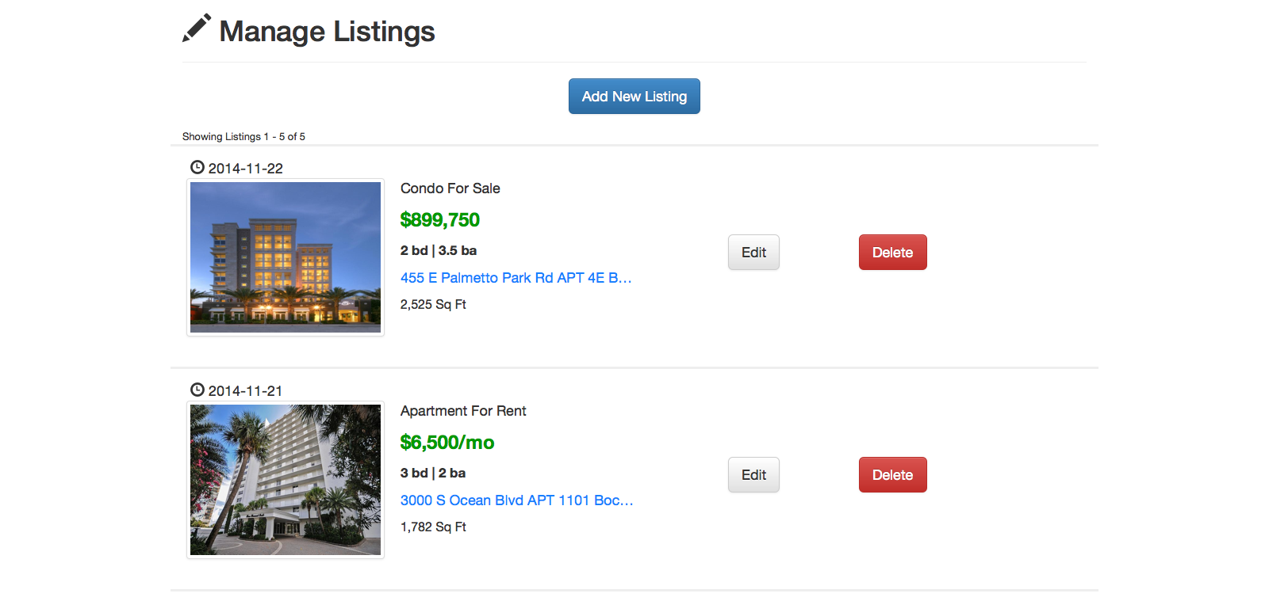
Easy to use (Continued)
Managing Your Listings is Easy

Slide 8
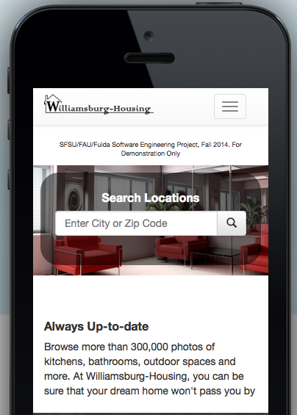
Mobile Friendly

Slide 9
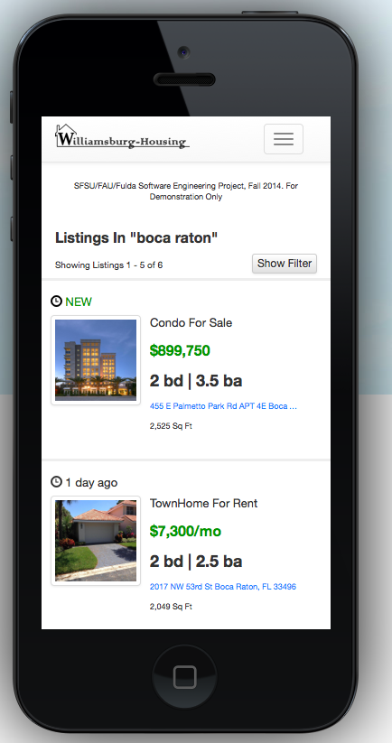
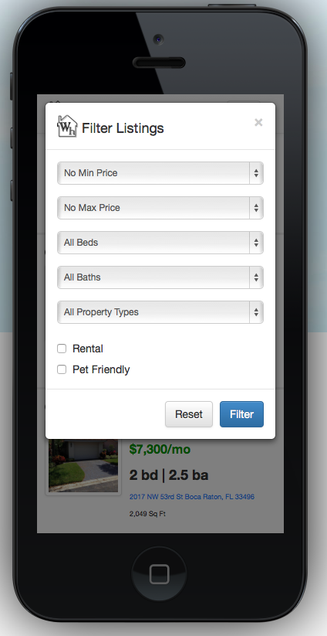

Slide 10
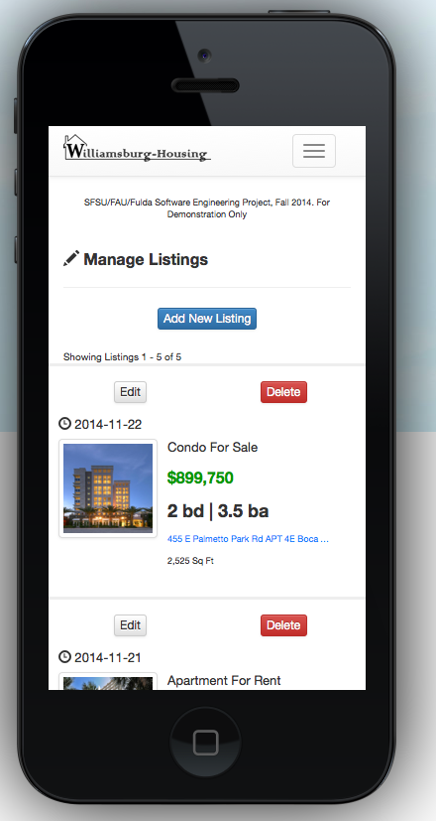
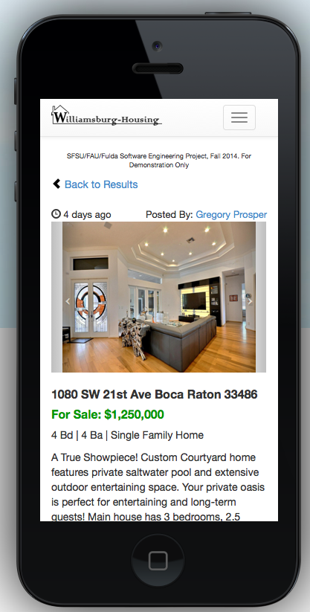

Slide 11
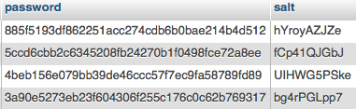
Secure
Standard Hashing and Salting of Passwords is Used

Slide 12
Demo
http://sfsuswe.com/~f14g30

